Slide 1
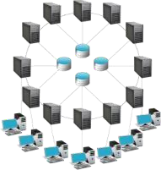
Introduction to Distributed Systems
Assoc.Prof.James Rwigema

Slide 2
Contents
Introduction
Why Distributed Computing
Advantages and Disadvantages of DS
Goals of DS
DS challenges
DS Architectural Model
Types of DS

Slide 3
1. Introduction-1
Distributed Systems have been in existence since the start of the universe.
In the real world, there is a need of increase of the information usages and their accessibility regardless where there located.
The proliferation of the internet and the emerging global village, the notion of distributed computing systems as a useful and widely deployed tool is becoming a reality.
The scenario is you know you are using one when the crash of a computer you have can’t prevent you from doing the work.

Slide 4
Introduction-2
A distributed system is a collection of independent entities that cooperate to solve a problem that cannot be individually solved.
Distributed system can be characterized as a collection of mostly autonomous processors communicating over a communication network.
Distributed computing refers to the mean by which a single computer program runs in more than one computer at the same time.
In distributed computing a program is split up into parts than run simultaneously on multiple computers communicating over a network.

Slide 5
Introduction-3
Distributed Computing
  A system in which hardware or software components located at networked computers communicate and coordinate their actions only by passing messages.
  A collection of independent computers that appear to its users as a
single coherent system.
  A parallel computer is implicitly a distributed system.
Examples:
Network of workstations
Distributed manufacturing system (e.g., automated assembly line)
Network of branch office computers.

Slide 6
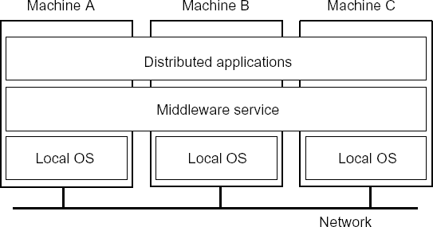
Introduction-3
Distributed Computing deals
with hardware and software systems
containing more than one processing element or storage element, concurrent processes, or multiple programs running under a loosely or tightly controlled regime.
Two aspects:
  Hardware: - autonomous computers
  Software: - users think they are dealing with a single system

Slide 7

Introduction-4
Ingredients of a Distributed System
Component-1 | … | Component-n
Network OS
Hardware
Component-1 | … | Component-m
Network OS
Hardware
Host-1
Host-n
Component-1 | … | Component-n
Middleware
Network OS
Hardware
Host-1

Slide 8


Introduction-5
Component-1 | … | Component-n
Middleware
Network OS
Hardware
Component-1 | … | Component-n
Middleware
Network OS
Hardware
Host-1
Host-2
Network
Component-1 | … | Component-n
Middleware
Network OS
Hardware
Component-1 | … | Component-n
Middleware
Network OS
Hardware
Host-n
Host-3

Slide 9
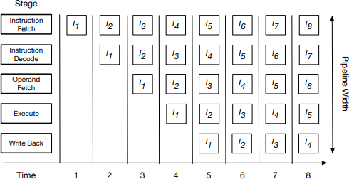
Why Parallel and distributed Computing-2 ?
– Instruction level parallelism (ILP) (90’s)

Slide 10
In computation, parallel systems with multi-core processors are going to over perform mainstream.
  Lots of hardware, software, and human issues in mainstream parallel/distributed computing
    How to make use a large number of processors simultaneously
    How to write parallel programs easily and efficiently?
    What kind of software supports is needed?
    Analyzing and optimizing parallel programs is still a hard problem.
    How to debug concurrent program?

Slide 11
3. Advantages of Distributed System over Centralized systems
Economics: a collection of microprocessors offer a better
price/performance than mainframes.
Speed: a distributed system may have more total computing power than a mainframe. Ex. 10,000 CPU chips, each running at 50 MIPS. Enhanced performance through load distributing.
Inherent distribution: Some applications are inherently distributed. Ex. a supermarket chain.
Reliability: If one machine crashes, the system as a whole can still
survive. Higher availability and improved reliability.
Incremental growth: Computing power can be added in small increments. Modular expandability.
Another deriving force: the existence of large number of personal
computers, the need for people to collaborate and share information.

Slide 12
Advantages of Distributed Systems over Independent PCs
Data sharing: allow many users to access to a common distributed database.
Resource Sharing: expensive peripherals like color printers.
Communication: enhance human-to-human communication, E.g.: email, chat.
Flexibility: spread the workload over the available machines.

Slide 13
Disadvantages of Distributed Systems
Software: difficult to develop software for distributed systems
Network: Saturation, lossy transmissions
Security: Easy access also applies to secret data

Slide 14
4. Distributed System Goals
Allow users to access and share resources:
Transparency
– To hide fact that its processes and resources are physically distributed across multiple computers.
Openness
  To offer services according to standard rules that describe the syntax and semantics of those services.
  E.g.: Specify interfaces using an interface definition language
(IDL)
Scalability
  Possibility of making the system expends in any dimension.

Slide 15
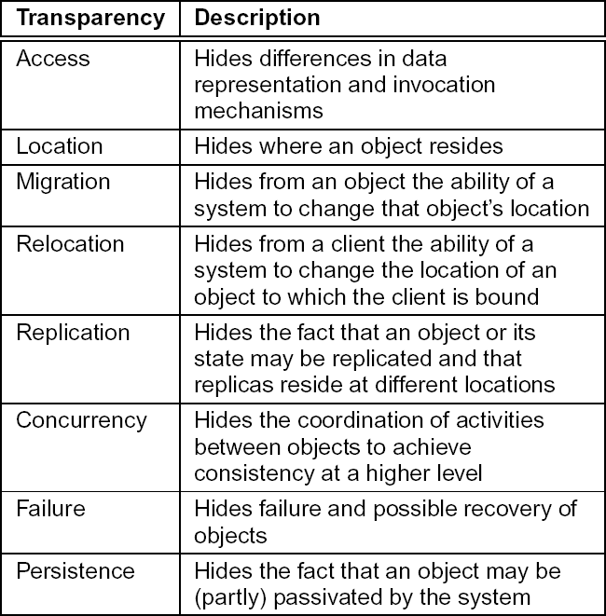
Distributed Systems Goals in details
1. Transparency characteristics are shown bellow
Distributed Computing @202149-2200250
24

Slide 16
1. Transparency (cont’d)
Aiming at full transparency may be too much:
Users may be located in different continents; distribution is apparent
and not something you want to hide.
Completely hiding failures of networks and nodes is (theoretically
and practically) impossible.
  You cannot distinguish a slow computer from a failing one.
  You can never be sure that a server actually performed an operation
before a crash.
Full transparency will cost performance, exposing distribution of the
system
  Keeping Web caches exactly up-to-date with the master copy
– Immediately flushing write operations to disk for fault tolerance

Slide 17
2. Openness
Open distributed system: Be able to interact with services from
other open systems, irrespective of the underlying environment:
  Systems should conform to well-defined interfaces
  Systems should support portability of applications
  Systems should easily interoperate
The challenge will be how to achieve openness:
At least make the distributed system independent from
heterogeneity of the underlying environment:
  Hardware
  Platforms
  Languages

Slide 18
2. Openness (cont’d)
c. Implementing openness: Requires support for different policies
specified by applications and users:
What level of consistency do we require for client cached data?
Which operations do we allow downloaded code to perform?
Which QoS requirements do we adjust in the face of varying bandwidth?
What level of secrecy do we require for communication?
Ideally, a distributed system provides only mechanisms:
  Allow (dynamic) setting of caching policies, preferably per cacheable item.
  Support different levels of trust for mobile code
  Provide adjustable QoS parameters per data stream
  Offer different encryption algorithms

Slide 19
3. Scalability
Many developers of modern distributed systems easily use the adjective “scalable” without making clear why their system actually scales.
At least three components must be cared about:
  Number of users and/or processes (size scalability)
  Maximum distance between nodes (geographical scalability)
  Number of administrative domains (administrative scalability)
Most systems account only, to a certain extent, for size scalability. The (non)solution: powerful servers.
Today, the challenge lies in geographical and administrative scalability.

Slide 20
3. Scalability: Techniques of Scaling
Hiding Communication Latency
  Move computations to clients
Distribution: Partition data and computations across multiple machines:
  Move computations to clients (Java applets)
  Decentralized naming services (DNS)
  Decentralized information systems (WWW)
Replication: Make copies of data available at different machines:
  Replicated file servers (mainly for fault tolerance)
  Replicated databases
  Mirrored Web sites
  Large-scale distributed shared memory systems
Caching: Allow client processes to access local copies:
  Web caches (browser/Web proxy)
  File caching (at server and client)

Slide 21
3. Scalability: Scaling problem
Applying scaling techniques is easy, except for one thing:
  Having multiple copies (cached or replicated), leads to inconsistencies: modifying one copy makes that copy different from the rest.
Always keeping copies consistent and in a general way requires
global synchronization on each modification.
  Global synchronization makes large-scale solutions practically impossible.
  If we can tolerate inconsistencies, we may reduce the need for
global synchronization.
    Tolerating inconsistencies is application dependent.

Slide 22
5. Distributed Systems Challenges-1
1. Heterogeneity: They must be constructed from a variety of different
networks, OS, Computer HW, and programming languages.
Openness: DS should be extensible, the integration of components written by different programmer is a challenge.
Security: Encryption is used to provide protection to shared resources
and keeping sensitive information secret when transmitted. However
denial of service (DoS) attacks are still a problem.
4. Scalability: A DS is scalable if the cost of adding a user is a constant amount in terms of the resources that must be added.
5. Failure handling: any process, computer or network may fail independently of the others. Each component need to be aware of the possible ways. DS need to be designed to deal with each of these failures.

Slide 23
Distributed Systems Challenges-2
Concurrency: Presence of multiple users is a source of concurrent requests to the resources. Each resource must be designed to be safe in a concurrent environment.
Transparency: The aim is to make certain aspects of distribution invisible to the application programmer so that they need only be concerned with the design of their particular application.
Quality of Service (QoS): It is not sufficient to provide access to services in distributed systems. It is also important to provide guarantees regarding the qualities associated with such service access. (like performance, security, and reliability).

Slide 24
False assumptions when developing DS
The network is reliable
The network is secured
The network is homogeneous
The topology does not change
Latency is zero
Bandwidth is infinite
Transport cost is zero
There is one administrator

Slide 25
6. Distributed Systems: Hardware concepts
Multiprocessors
Multicomputer
Networks of computers

Slide 26
Distributed Systems: Hardware concepts
Multiprocessors
  Multiprocessing is the use of two or more CPUs within a single computer system.
  Multiprocessor is a computer system having two or more processing
units (multiple processors) each sharing main memory and
peripherals, in order to simultaneously process programs.
Processor symmetry:
In a multiprocessing system, all CPUs may be equally participating , or some may be reserved for special purposes.
Systems that treat all CPUs equally are called Symmetric
Multiprocessing (SMP) systems
Asymmetric Multiprocessing (ASMP).
Non- Uniform Memory Access (NUMA)
Clustered Multiprocessing

Slide 27
Distributed Systems: Hardware concepts
Multiprocessors Communication Architecture
Message Passing
  Separate address space for each processor
  Processors communicate via message passing
  Processors provide local message queue memories
  Focus attention on costly non-local operations
Shared Memory
  Processors communicate with shared address space
  Processors communicate by memory read/write
  Easy on small-scale machines
  Lower latency

Slide 28
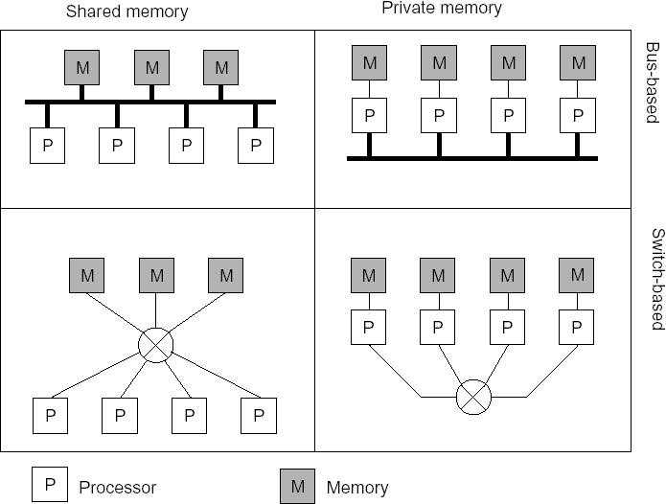
Distributed Systems: Hardware concepts
Distinguished features:
  Private vs shared memory
  Bus vs switched interconnection

Slide 29
3. Networks of Computers
High degree of node heterogeneity:
  High-performance parallel systems multicomputer)
(multiprocessors as
well as
High-end PCs and workstations (servers)
Simple network computers (offer users only network access)
Mobile computers (palmtops, laptops)
High degree of network heterogeneity:
  Local-area gigabit networks
  Wireless connections
  Long-haul, high-latency POTS connections
  Wide-area switched megabit connections
Observation: Ideally, a distributed system hides these differences

Slide 30
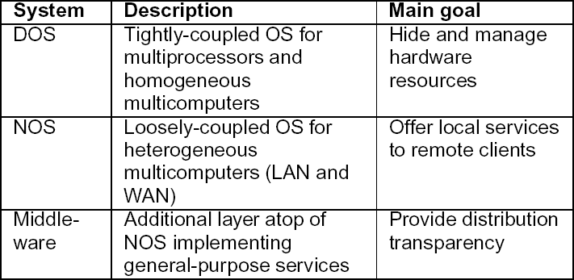
Distributed Systems: Software concepts
Distributed Operating System
Network Operating System
Middleware

Slide 31
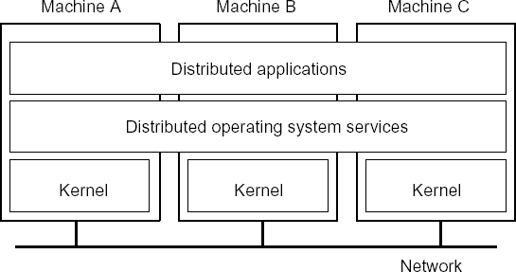
Distributed Systems: Software concepts
Distributed Operating System
  Some characteristics
    OS on each computer knows about the other computers
    Services are generally (transparently) distributed across computers

Slide 32
Distributed Systems: Software concepts
- Multicomputer Operating System
Harder than traditional (multiprocessor) OS: Because memory is not shared, emphasis shifts to processor communication by message passing:
  Often no simple global communication:
    Only bus-based multi-computers provide hardware broadcasting
    Efficient broadcasting may require network interface
programming techniques
  No simple system-wide synchronization mechanisms
  Virtual (distributed) shared memory requires OS to maintain global memory map in software
  Inherent distributed resource management: no central point where
allocation decisions can be made
Practice: Only very few truly multicomputer operating systems exist (example: Amoeba)

Slide 33
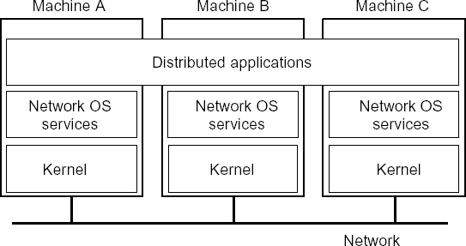
Distributed Systems: Software concepts
Network Operating Systems
– Some characteristics:
Each computer has its own operating system with networking facilities
Computers work independently (i.e., they may even have different
operating systems)
Services are tied to individual nodes (ftp, telnet,WWW)
Highly file oriented (basically, processors share only files)

Slide 34
Distributed Systems: Software concepts
Middleware
– Is the software
applications.
that connects software components or enterprise
– Middleware is the software layer that lies between the operating system and the applications on each side of a distributed computer network.

Slide 35
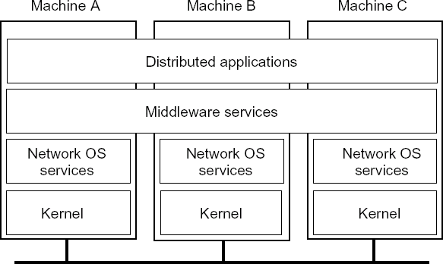
Distributed Systems: Software concepts
Middleware
  Some characteristics:
    OS on each computer need not know about the other computers
    OS on different computers need not generally be the same
    Services are generally (transparently) distributed across computers

Slide 36
Distributed Systems: Software concepts
Needs for Middleware
Motivation: Too many networked applications were difficult to integrate:
  Departments are running different NOSs
  Integration and interoperability only at level of primitive NOS Services
Need for federated information systems:
  Combining different databases, but applications
providing a single view to
Setting up enterprise-wide Internet services, making use of existing information systems
Allow transactions across different databases
Allow extensibility for future services (e.g., mobility, tele-working)
Constraint: use the existing operating systems, and treat them as the
underlying environment

Slide 37
Distributed Systems: Software concepts
Middleware Services
Communication services: Abandon primitive socket-based message passing in favor of:
  Procedure calls across networks
  Remote-object method invocation
  Message-queuing systems
  Advanced communication streams
  Event notification service
Information system services: Services that help manage data in a distributed system:
  Large-scale, system-wide naming services
  Advanced directory services (search engines)
  Location services for tracking mobile objects
  Persistent storage facilities
  Data caching and replication

Slide 38
Distributed Systems: Software concepts
Control services: Services giving applications control over when,
where, and how they access data:
  Distributed transaction processing
  Code migration
Security services: Services for secure processing and communication:
  Authentication and authorization services
  Simple encryption services
  Auditing service

Slide 39
Distributed Systems: Software concepts
Comparison of NOS, DOS, and Middleware
  Degree of transparency.
  Same operating system on each node?
  Number of copies of the operating system.
  Basis for communication.
  How are resources managed?
  Is the system easy to scale?
  How open is the system?
Distributed Computing @2019-2020

Slide 40
7. DS Architecture Models
The architecture of a system is its structure in terms of
separately specified components and their
interrelationships.
The overall goal is to ensure that the structure will meet present and likely future demands on it.
The architectural design of a building has similar aspects.

Slide 41
Architecture Models-2
Architectural Elements
To understand the fundamental building block of DS, it is necessary
to consider four key questions:
What are the entities that are communicating in the DS?
How do they communicate, or , what communication
paradigm is used?
3. What roles and responsibilities do they have in the overall architecture?
4. How are they mapped on to the physical distributed infrastructure (placement)?

Slide 42
Architectural Elements
What are the entities that are communicating in the DS?
  The entities that communicate in a DS are processes. Reading
to inter-processes communication paradigms.
  In some primitive environments, such as sensor networks, the entities that communicate are nodes.
  In most distributed Systems environments, processes are supplemented by threads, it is threads that are the endpoints of communication.
  Problem-oriented abstractions have been proposed:
    OBJECTS: Proposed to encourage the use of OO approaches in DS.
COMPONENTS: resemble
objects in that they offer problem-
oriented abstractions for building DS and are also accessed
through interface.

Slide 43
Architectural Elements
How do they communicate, or , what communication paradigm
is used?
  Communication paradigm
    Inter-process communication: Communication between processes in DS, including message-passing primitives, direct access to the API offered by Internet protocol (Socket Programming)
    Remote invocation: Based on a two-way exchange between communicating entities in a DS and resulting in the calling of a remote operation, procedure or method.
- Request-reply protocols: a pattern imposed on an underlying message-passing service to support client-server computing.

Slide 44
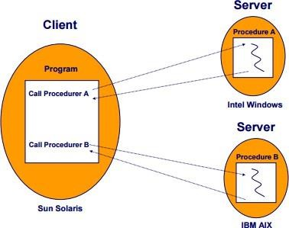
Architectural Elements
Communication paradigm
- Remote procedure calls (RPC): the procedures in processes on remote computers can be called as if they are procedures in the local address space.

Slide 45
Architectural Elements
Communication paradigm
- Remote method invocation (RMI): resembles RPC but
in a world of distributed objects.
=> This communication represents a two-way relationship between SENDER and RECEIVER, with senders explicitly directing messages/invocations to the associated receivers.

Slide 46
Architectural Elements
c. Indirect communication
Senders do not need to know who they are sending to (space
uncoupling)
Senders and receivers do not need to exist at the same time (time coupling)

Slide 47
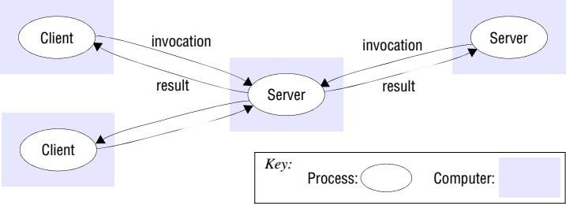
Architectural Elements
Roles and responsibilities
  Client – Server
Client processes interact with individual server processes in order to access the shared resources that they manage.
Servers may in turn be clients of other servers.
Eg,: WEB SERVER

Slide 48
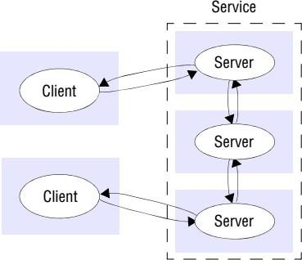
Architectural Elements
A service provided by multiple servers

Slide 49
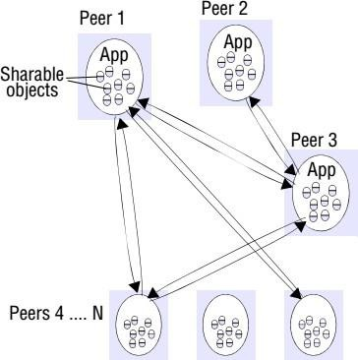
Architectural Elements
Peer-to-peer
All the processes involved in a task or activity play similar roles.
Interacting cooperatively as peers without any distinction between client and server processes or the computers on which they run.

Slide 50
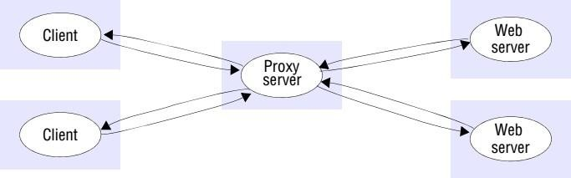
Architectural Elements
4. Placement
The final issues to be considered is how entities such as objects or
services map on to the underlying physical distributed infrastructure
Placement must be determined with strong application knowledge
and there are few universal guidelines placement strategies.
1. Mapping of Services to multiple servers
Services may be implemented as several server processes in separate host computers interacting as necessary to provide a service to client processes

Slide 51
Architectural Elements
Caching
  A cache is a store of recently used data objects that is closer to
one client or a particular set of clients than the objects
themselves.
When a new object is received from a server it is added to the
local cache store, replacing some existing objects if necessary.
When an object is needed by a client process, the caching service first checks the cache and supplies the object from there if an up-to-date copy is available.
If not, an up-to-date copy is fetched.
Caches may be co-located with each client or they may be located in a proxy server that can be shared by several clients.

Slide 52
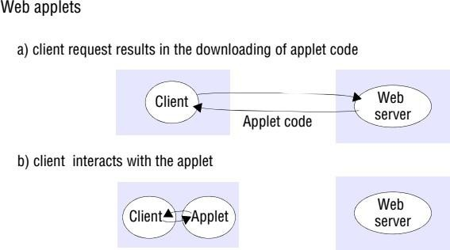
Architectural Elements
Caching example

Slide 53
Architectural Elements
Mobile code
  Accessing services means running code that can invoke their
operations.
  Some services are likely to be so standardized that we can access them with an existing and well-known application – the Web is the most common example of this, but even there, some web sites use functionality not found in standard browsers and require the downloading of additional code.
Mobile agents
  A mobile agent is a running program (including both code and data) that travels from one computer to another in a network carrying out a task on someone’s behalf, such as collecting information, and eventually returning with the results.

Slide 54
Types of Distributed Systems-1
The nodes in the distributed computing can be arranged in the form of:
  Client/Server systems
  Peer to peer Systems

Slide 55

Client-Server Model
Servers: Generally provide services related to a shared resource:
  Servers for file systems, databases, implementation repositories, etc.
  Servers for shared, linked documents (Web, VoD)
  Servers for shared applications
  Servers for shared distributed objects
Clients: Allow remote service access:
  Programming interface transforming client’s local service calls to
request/reply messages
  Devices with (relatively simple) digital components (barcode readers, teller machines, hand-held phones)
  Computers providing independent user interfaces for specific services
  Computers providing an integrated user interface for related services
(compound documents)

Slide 56
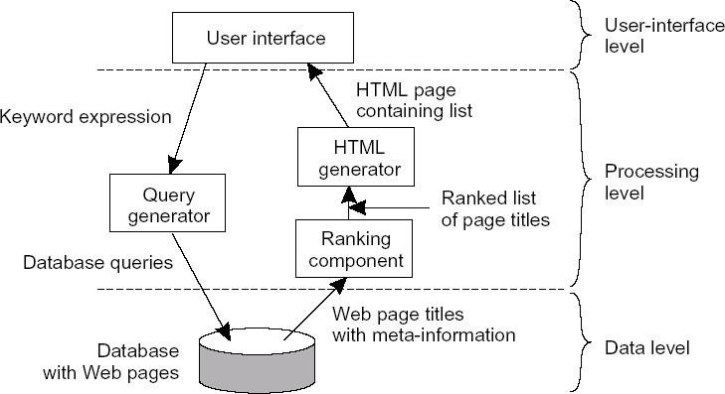
Client-Server Model
Application Layering

Slide 57
P2P Model
Peer-to-peer (P2P) computing or networking is a distributed application architecture that partitions tasks or workloads between peers.
Peers are equally privileged, equipotent participants in the application. They are said to form a peer-to-peer network of nodes.
Peers make a portion of their resources, such as processing power, disk storage or network bandwidth, directly available to other network participants, without the need for central coordination by servers or stable hosts

Slide 58
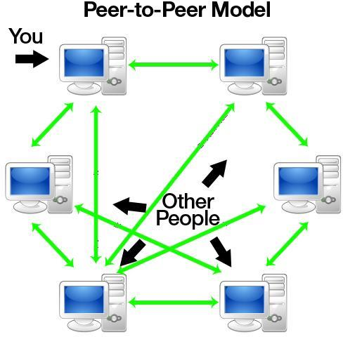
P2P Model
Peer to Peer DS
•

Slide 59

End

